Slide 1
Campus Video & Photo
What’s new, tips & techniques
Mike Shaw
Associate Director, Social Media Video
Wake Forest University

Slide 2
Hi, I’m Mike Shaw.
Associate Director, Social Media Video @WakeForest
Former Digital Marketing Specialist at Guilford College
Former reporter at The Roanoke Times (Va.)
Wingate University alumnus (2011)
@MikeShawVideo
shawms@wfu.edu

Slide 3
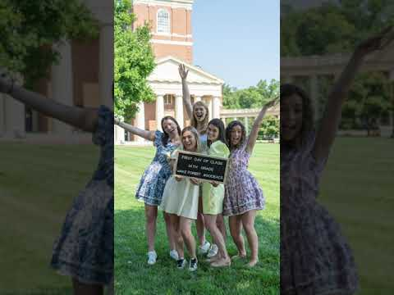
Notes:
So what’s trending in video?
If you’ve been on social for any amount of time, you know that can change in an instant
But one continued trend we’ve seen over the past few years is VERTICAL video
In our time together I’ll share why vertical video is a trend that’s here to stay (and here’s why).
Here are four reasons why it’s here to stay:
The biggest social platforms have embraced it - and succeeded
You’re making videos that are made for social first - you actually care about your social audience
Vertical videos provide mobile viewers a better user experience - and that’s important
Evidence is growing - vertical videos outperform standard videos on social

Slide 4
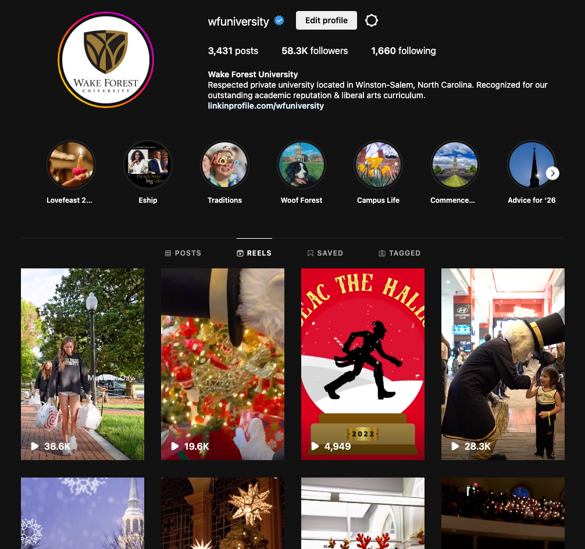
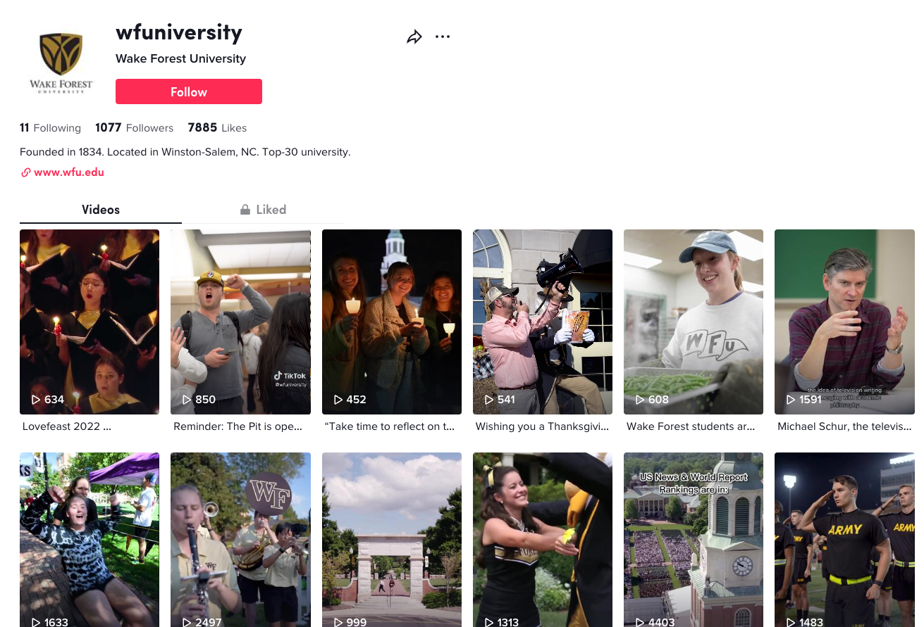
Social Embrace
Notes:
Here’s a look at Instagram Reels and TikTok.

Slide 5
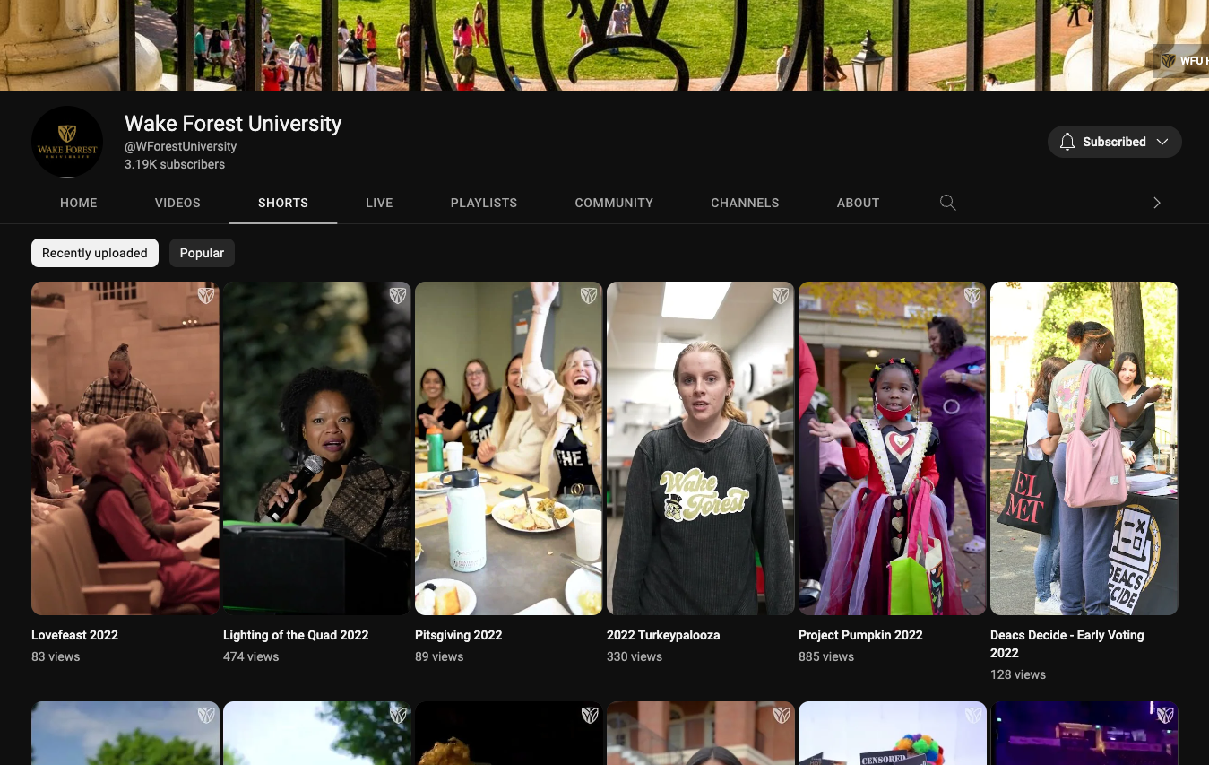
Social Embrace
Notes:
And here’s a look at YouTube Shorts.
While Facebook, Twitter and LinkedIn don’t have a set “space” for vertical video, vertical videos fill a mobile screen in the timeline. It’s a nice look.
Social media has embraced the vertical video - and you should, too.

Slide 6
Social Embrace
That looks nice, but does it matter?
More than 2 billion people interact with Reels
Reels get 22% more interaction than standard
TikTok has over 1.5 billion active monthly users
Over 1 billion videos are watched every day
YouTube has more than 2.6 billion active users
52% of Internet users access YT once per month
YT Shorts receive 15 billion views every day
Notes:
So, that looks nice, but I want some hard evidence that it’s worth my time…
According to DemandSage, a data intelligence software company:
More than 2 billion people on Instagram interact with reels every month
Reels get 22% more interaction on Instagram than standard video postings
Interesting fact: Reels and TikTok are perceived as being “essentially the same” by 87% of Gen. Z
TikTok has over 1.5 billion active monthly users and over 3 billion people have downloaded TikTok to date
Over 1 billion videos are watched every day on TikTok
YouTube has long been the king of social video, but even it has adapted to the vertical video trend.
YouTube Shorts launched Sept. 2020 and has gained steam since.
YouTube has more than 2.6 billion active users
52% of Internet users access YouTube at least once per month
YouTube Shorts receive 15 billion views daily (I’ve seen it as high as 30 billion)

Slide 7
Made-for-Social Video
Here’s how to show you care…
How can you compete in the social space?
Meet your audience where they are
Make it easy for your content to be viewed
More than 90% of social users are on mobile
How do we hold those phones? Vertically
Notes:
OK, but who cares about the social embrace?
Well, you should…
Social media is a competition. You’re competing against your peers (even aspirants), local businesses, national brands and anyone else taking up space in the digital world.
Meeting your audience where they are can give you a “leg up” on the competition
Your goal should be to make it as easy as possible for your video to be consumed
It’s widely accepted that the majority of social browsing happens on mobile devices
In fact, SEO company Backlinko reports that over 90% of all social users access social media via mobile devices
And how do we hold our phones? Vertically

Slide 8
Mobile User Experience
How does vertical video help?
We hold our phones vertically 94% of the time
Over 90% of social users are on a mobile device
In 2012, only 14% of videos were seen on mobile
> 60% of YT videos are now viewed on mobile
Notes:
Let’s take a moment to imagine our end user…
They’re swiping up checking their Twitter timeline
They see photos. There’s some text. News stories. Ah, there’s a video.
They tap the video and it opens “full screen”
If the video is horizontal, they’ll now have to choose between watching a small version of it, or…
They need to rotate their phone - a seemingly unnecessary step in the UX process
According to Wyzowl, studies suggest we hold our phones vertically 94% of the time
Now think back to the over 90% stat I mentioned in the last slide - 90% of social users are consuming on their phone
In 2012, an estimated 14% of videos were viewed on mobile
Now, more than 60% of Youtube videos are viewed on a mobile device (YouTube was desktop first focused - and king of video)
It’s amazing how quickly the trend has grown - and will continue to grow.

Slide 9
Vertical Videos Perform Better
Notes:
Vertical videos perform better. Because they’re the best.
OK, so that’s a bold statement - and Jimmy looks like he agrees.
But seriously, nothing about what I’ve said today will make you go back to your office and pitch vertical video
In fact, I’m guessing your friendly, neighborhood videographer will look at you sideways
You can Google vertical video stats, pros and cons until your head spins.
The truth is - vertical video simply outperforms its standard video sibling on social media.

Slide 10
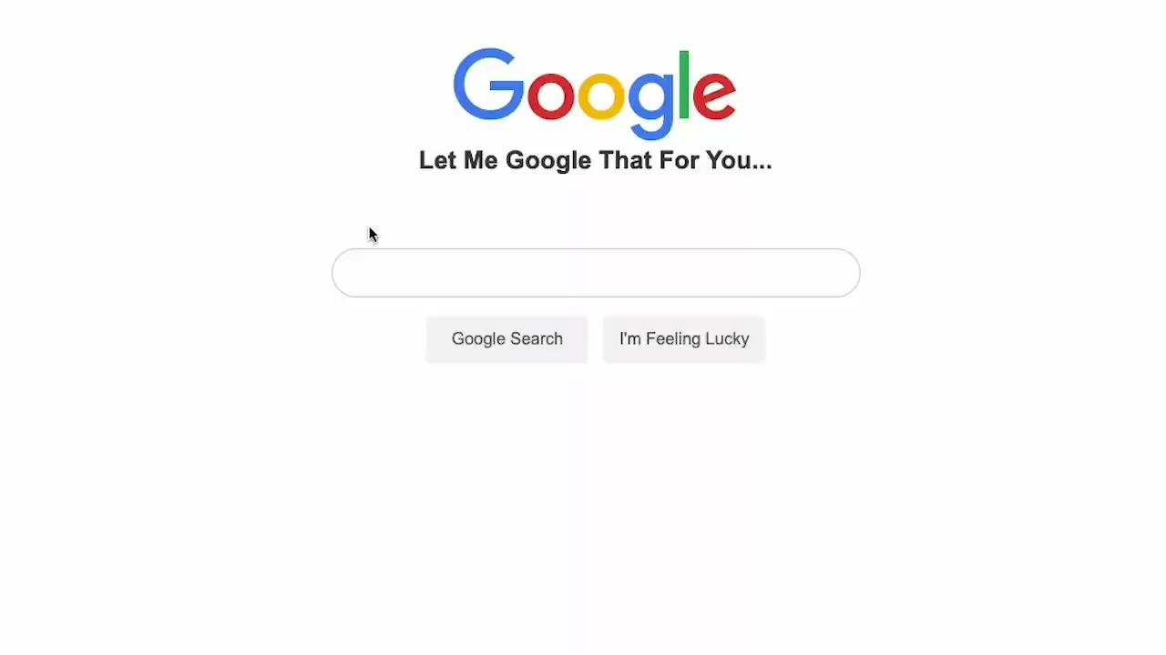
Notes:
You can fire up the Google machine to fact check, but by now you know higher education social media (HESM) doesn’t rank high in searches.
So, instead of wasting time, let’s take a look at Wake’s social views over the past few years to see if I can convince you to give vertical video a chance…

Slide 11
Notes:
Here’s Wake Forest’s first vertical video - the one that changed it all for us.
This was posted as a commencement primer video in May 2021 as a test on Instagram.
We had some questions:
What’s this new Reels thing all about?
How would this perform?
Would it be well received?
Can we shoot vertical video?
And then, it happened. That video was viewed more than 20,200 times.
Before that, an average WFU Instagram video was viewed 5,000 times. Since then, Wake Instagram videos are averaging about 28,000 views.
If we take a step back and consider total views for a single video across all platforms (YouTube, Facebook, Twitter, LinkedIn, Instagram and TikTok), here’s where we stand:
2021 (before vertical videos) - 11,000 views per video on average
2021 (using vertical videos) - 40,000 views per video on average
2022 - 35,000 views per video on average
The use of vertical video transformed our views, interaction and engagement.

Slide 12
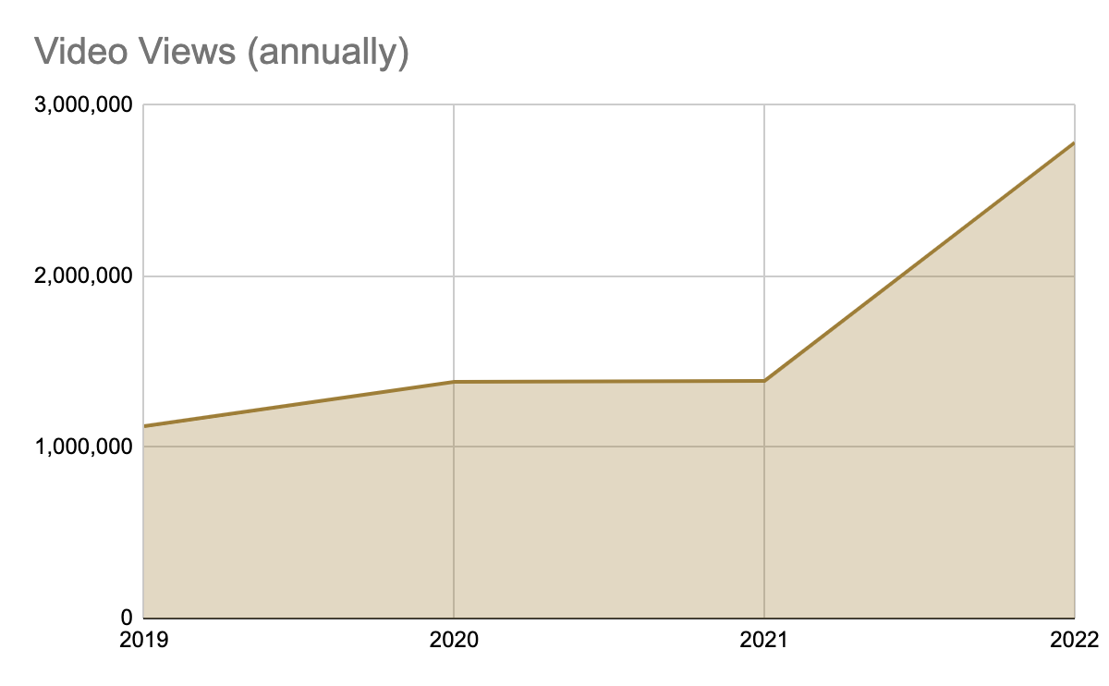
Notes:
Let’s step back again and look at total views annually for our videos.
You can see the jump in 2021 when we switched over to vertical video.
2019 - 1.1 million views
2020 - 1.3 million views
2021 - 1.38 million views (when we started using vertical)
2022 - 2.7 million views

Slide 13
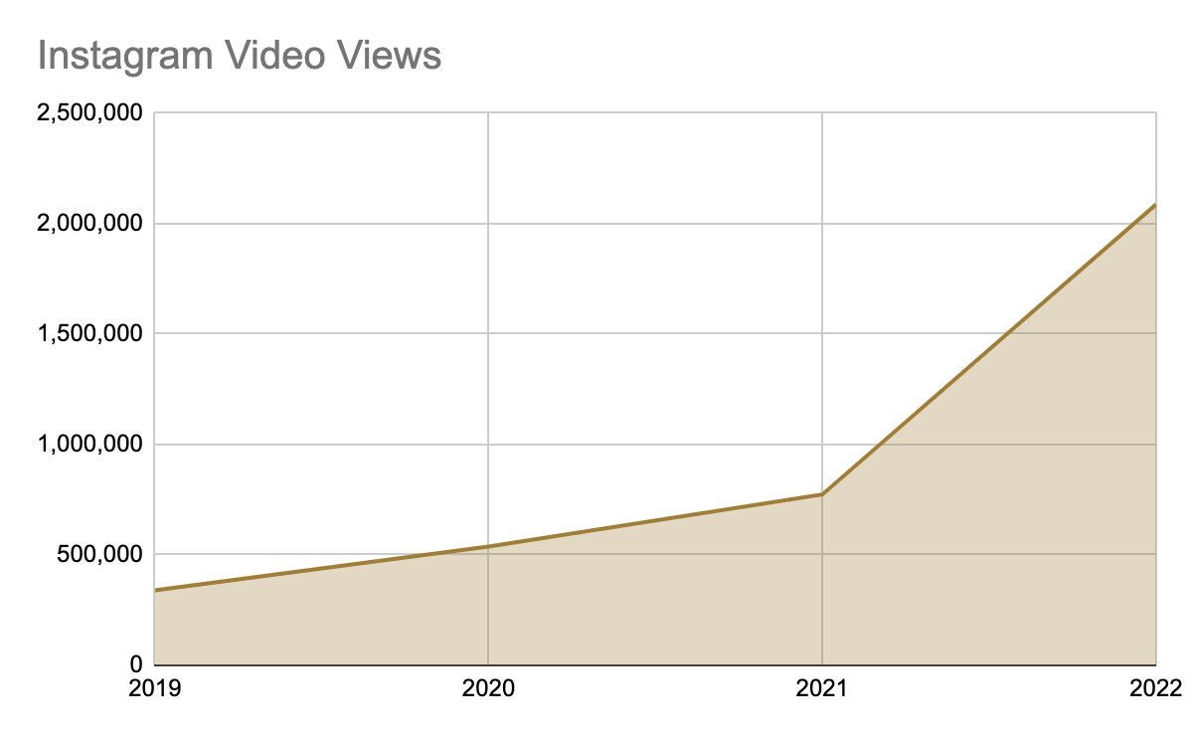
Notes:
And Instagram has been a huge driver behind these numbers.
Here’s a look at Instagram video views since 2019. Again, noticing a jump in 2021.
2019 - 339,000 views
2020 - 538,000 views
2021 - 773,000 views
2022 - 2 million views
Ok, so maybe the trend should have been Instagram Reels is now king?

Slide 14
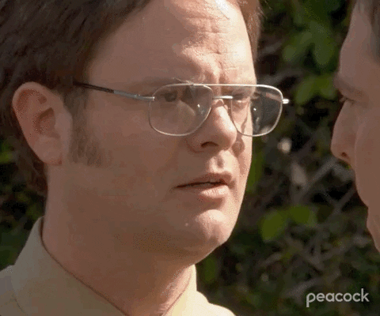
Notes:
Again, that’s a super high level overview to point out how our views have been transformed by vertical video.
So how can you get started?
Just DO IT. NOW.

Slide 15
Getting Started
Tips to wade into the vertical video water…
Simple video concept (campus beauty)
Use your cell phone to capture!
Find a nice music bed in app to use
Write a clever, institutional-centric caption
POST IT. Don’t be afraid.
Notes:
Here are some simple ways to get started.
Find a simple video to shoot (think campus beauty, fun event, etc.)
Use a cell phone (and all the tips Megan taught you) to capture the video
Find a nice music bed in the Instagram app to use with your video (or license something if needed)
Come up with a clever caption
POST IT. Don’t be afraid.

Slide 16
How to Keep it Going
Next steps
What’s trending?
Use the inverted pyramid
Tell a story
Use the right dimensions (hello, vertical)
The details matter
Notes:
And here’s how to keep it going.
Original videos are key to any social video plan, but keeping an eye on trends is vital. How can you capitalize on a trend? How can you make a trend specific to your College or University?
Inverted pyramid - most viewers swipe by or drop off the video fast. Hook them by putting the most important part (or best shots) of your video up front.
Tell a story - it’s what communicators are meant to do, right? You hooked them, now keep them there with compelling content.
We just talked about this for what seems like forever (vertical, baby!).
The details matter - Use voiceover, interviews, music beds and captions to complement your video. Create a dynamic package for the viewer.
Most importantly - get out there and start recording!

Slide 17
Questions?
@MikeShawVideo
shawms@wfu.edu

